Slide 1
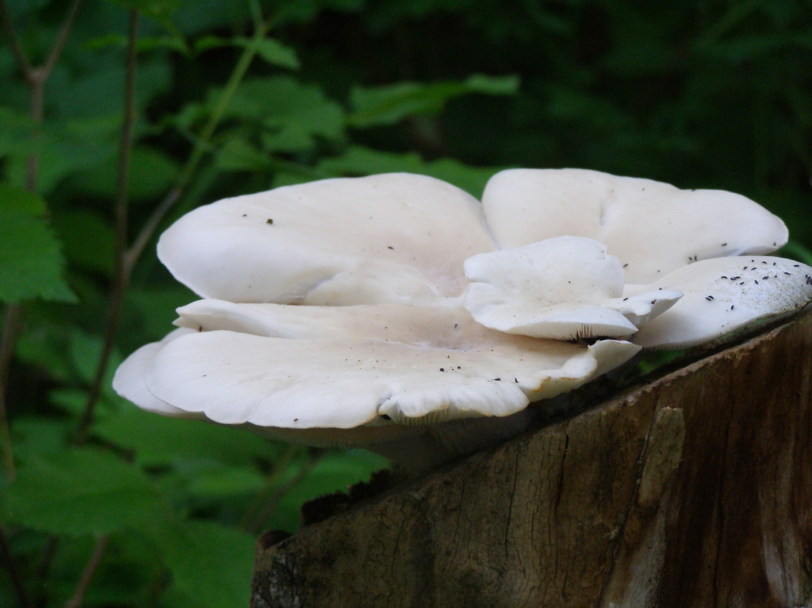
There is Fungus Among Us: Soil Communities and Plants
Siddharth Iyengar, Mayank Kohli, and S.G. Winikoff
December 3, 2014

Slide 2
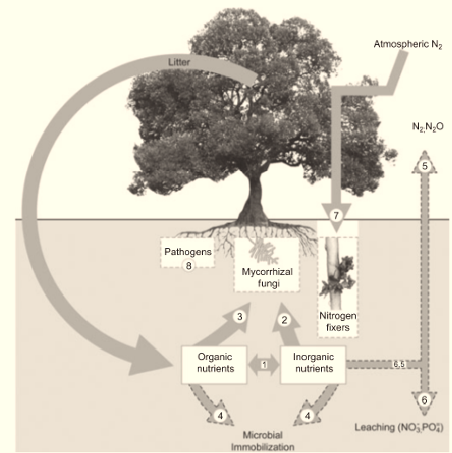
Belowground Processes Influence Aboveground Processes
In nutrient poor ecosystems microbes can supply up to 90% of growth limiting nutrients.
Symbionts and pathogens regulate plant diversity.
1
Van Der Heijden et al. 2008

Slide 3
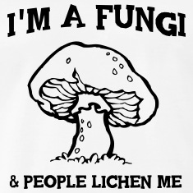
Fungus Among Us
Fungi are important mutualists (mycorrhizae, decomposers) and pathogens.
Strong interactions and local adaptation between plants and soil fungal communities (Johnson et al. 2010).
There are no manipulative field studies in natural ecosystems that address how fungal communities broadly interact with plants.
2

Slide 4

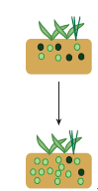
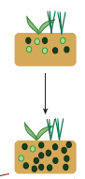
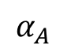

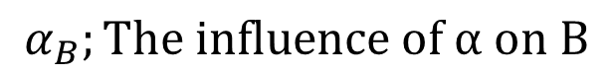
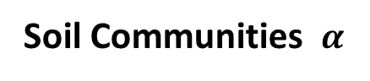
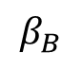
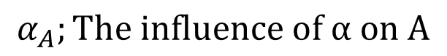
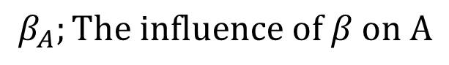
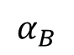
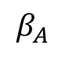
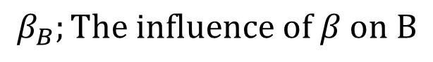
Theoretical Framework of Interactions
Plants A
B
$$β_{A}$$
$$α_{B}$$
$$α_{A}$$
$$β_{B}$$
Soil Communities $α$
$$β$$
$$α_{A};The influence of α on A$$
$$β_{B};The influence of β on B$$
$$α_{B};The influence of α on B$$
$$β_{A};The influence of β on A$$
3
Bever et al. 1997, Bever et al. 2012
Notes:
“Soil Community Associated with Plant A”

Slide 5






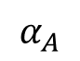
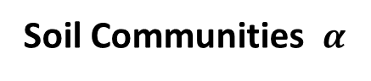
Theoretical Framework: Mutualist vs. Antagonist
Plants A
Mutualist
Antagonist
$$α_{A}$$
Soil Communities $α$
Mutualist communities improve the fitness of the plant species that fostered them.
Antagonist communities hinder the fitness of the plant species that fostered them.
4
Bever et al. 1997, Bever et al. 2012
Notes:
“To start off we will look at interactions with a single plant and soil community”
“Mutualism = Mycorrhizal fungi”
“Antagonism = Pathogens (Wheat Rust)”

Slide 6
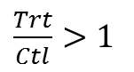
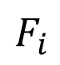
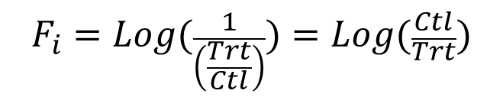
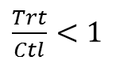
Measurements in a Monoculture
Fungi removal …
Increases the growth suggesting that Fungi are Antagonistic.
Decreases the growth suggesting that Fungi are Mutualistic.
Plant Growth
$\frac{Trt}{Ctl}>1$
1
$\frac{Trt}{Ctl}<1$
Ctl
Trt
Mutualism
$$F_{i}=Log(\frac{1}{\left(\frac{Trt}{Ctl}\right)})=Log(\frac{Ctl}{Trt})$$
$$F_{i}$$
0
Antagonism
A B C
Paired T-test: paired, annual measurements
Species
F_{i} > 0; Fungi are mutualistic
F_{i} < 0; Fungi are Antagonistic
5
Notes:
“ So how would we measure this “
“ If we removal Fungi … “

Slide 7
Study Design: Enemy Removal Experiment
5
1.5m
1
4
2m
2
Within a diversity manipulation experiment
Experiment area fenced for deer
41 plots each with 5 treatments
16 monoculture plots
Foliar fungicide, Insecticide, Soil fungicide, All, Control
3
9m
6
Cedar Creek Ecosystem Science Reserve E244, E245
Notes:
Our luck- someone has gone out and done just that!
Has been running since 2007 to test for effects of natural enemies on plants

Slide 8
Study Design: Enemy Removal Experiment
5
1.5m
1
4
2m
2
Biomass clipped from 1mx10cm
Sorted, dried and weighed
3 soil cores 2” wide, 30cm deep
Percent cover in 1m x 0.5m of rooted species
3
9m
7
Cedar Creek Ecosystem Science Reserve E244, E245
Notes:
Large plot has deer fence;

Slide 9
Plant cover does not change consistently
*
*
*
No spatial replicates. 6 temporal replicates for most species
8
Notes:
However there are species level differences which may be worth exploring in detail in follow up work..
Panicum virgatum is a switchgrass

Slide 10
Aboveground biomass: No overall or consistent effect
*
*
9
No spatial replicates. 6 temporal replicates for most species
Notes:
Asctu has only 2 replicates.

Slide 11
Root biomass: No overall or consistent effect
*
*
10

Slide 12
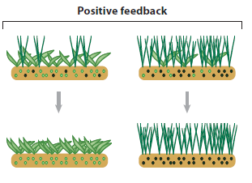
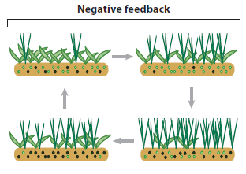
Theoretical Framework: Multi-Species Interactions
Mutualist
Antagonist
Mutualism: dominant soil community promotes ‘parental’ plant species dominance
Antagonism: maintains species diversity. Dominant soil community hinders ‘parental’ plant species.
New dominant plant species and soil community develop.
Cycle continues
11
Bever et al. 2012
Notes:
“ some species do seem to have an Antagonistic or Mutualistic relationship with their soil Fungi ”
“ But what happens when we are considering a community of plants AND their respective soil microbial communities? “

Slide 13
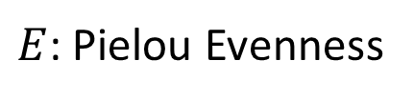
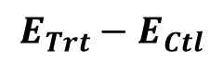
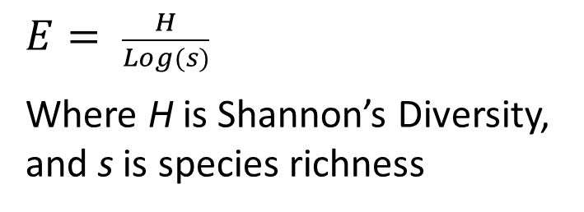
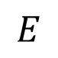
Measuring Shifts in Species Dominance
$E$: Pielou Evenness
$E= \frac{H}{Log(s)}$
Where H is Shannon’s Diversity, and s is species richness
$$E$$
Antagonist
Control
Mutualist
$$E_{Trt}−E_{Ctl}$$
Mutualism
Mutualism drives Dominance
M = ↑Evenness
Antagonism drives Diversity
A = ↓Evenness
0
Antagonism
A B C
Replicate
12
Notes:
“To visualize this we might use the following graph …”

Slide 14
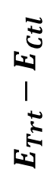
Results: Shifts in Dominance
$$E_{Trt}−E_{Ctl}$$
There was no clear and consistent shift in species dominance with respect to soil fungicide.
13

Slide 15
So What Does it All Mean?
At Cedar Creek, we can detect that some plant species are influenced by soil fungal antagonists and mutualists.
Plant-fungal interactions are more complex in natural ecosystems than in the lab and require further experimentation and analysis.
14

Slide 16
What Else Could be Going On Here?
We could be looking at the wrong response metric.
Soil Nutrient Availability
Tissue Chemistry
δ¹⁵N Uptake in Control and Treatment Plots
Bacteria might be pulling the bulk of the weight in these grasslands.
Plant size and longevity may influence whether plants have substantial relationships with fungi.
15

Slide 17
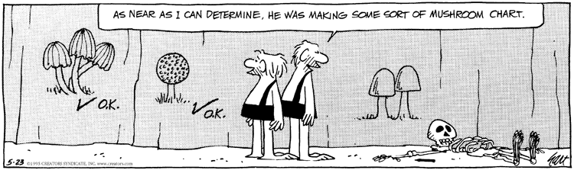
Acknowledgments
Cedar Creek Ecosystem Science Reserve
L. Kinkel & H. Muller-Landau – E244,245
E² Seabloom & Borer – E244, 245
D. Tilman, P. Reich, J. Knops, D. Wedin – E120
Thousands of Undergraduate Weeders and Staff
16

Slide 18
References
Bever, J.D., T.G. Platt, E.R. Morton. (2012).Microbial population and community dynamics on plant roots and their feedbacks on plant communities. Annu. Rev. Microbiol. 66: 265-283.
Bever, J.D., K.M. Westover, and J. Antonovics. (1997). Incorporating the soil community into plant population dynamics: the utility of the feedback approach. J. Ecol. 85(5): 561-573.
Johnson, N.C., G.W.T. Wilson, M.A. Bowker, J.A. Wilson, and R.M. Miller. (2010). Resource limitation is a driver of local adaptation in mycorrhizal symbioses. PNAS 107(5): 2093-2098.
Van Der Heijden, M.G., R.D. Bardgett, and N.M. Van Straalen. (2008). The unseen majority: soil microbes as drivers of plant diversity and productivity in terrestrial ecosystems. Ecol. Lett. 11: 296-310.
17

Slide 19
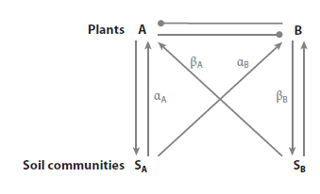
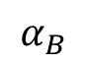
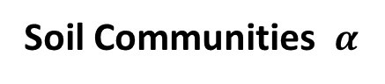
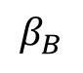
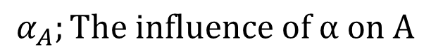
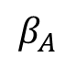
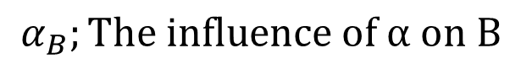
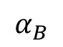
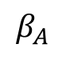
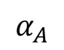
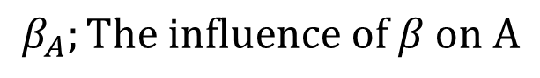

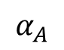
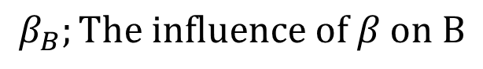
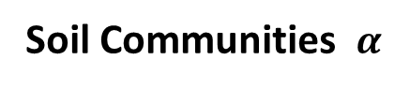
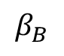

Theoretical Framework of Interactions
Plants A
B
$$β_{A}$$
$$α_{B}$$
$$α_{A}$$
$$β_{B}$$
Plants A
B
Soil Communities $α$
$$β$$
$$β_{A}$$
$$α_{B}$$
$$α_{A}$$
$$β_{B}$$
$$α_{A};The influence of α on A$$
$$β_{B};The influence of β on B$$
$$α_{B};The influence of α on B$$
$$β_{A};The influence of β on A$$
Soil Communities $α$
$$β$$
Bever et al. 1997, Bever et al. 2012

Slide 20
Measuring Species Specific Fungal Effect in Polyculture
F_{i}
eH
Dominant Mutualist improves competitive advantage.
Less dominant mutualist does not compete well.
Antagonism effect is diluted with increasing diversity.
Antagonist Dilution:

